Slide 1
Web Development Workshop
Introduction to Javascript, AngularJS & GitHub
Name: Amrapali Nayak
Date: 04/Mar/2025

Slide 2
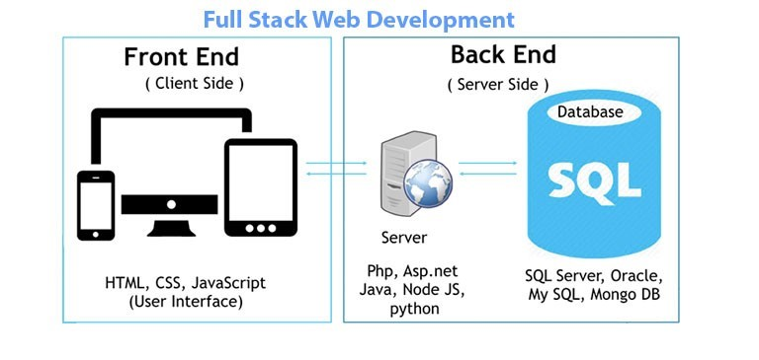
Web Application Components

Slide 3
Session Agenda
Introduction to GitHub & Project Setup
JavaScript Basics & Local Storage
Introduction to AngularJS & Data Binding
GitHub Commits & Collaboration
Assignment & Q&A

Slide 4
Introduction to GitHub
What is GitHub?
A cloud-based platform for version control and code collaboration
Built on top of Git, a distributed version control system
Allows developers to track changes, collaborate, and manage projects

Slide 5
Why GitHub?
Version Control: Keeps track of code changes and history
Collaboration: Multiple people can work on the same project simultaneously
Backup & Security: Your code is stored safely in the cloud
Open Source & Community: Share projects, contribute to others’ code
Integration: Works with various development tools and CI/CD pipelines

Slide 6
GitHub Account Setup
Students create GitHub accounts (if not already created)
Navigate to GitHub.com and sign up
Send access request to the workshop repository
Familiarization with GitHub Dashboard & Navigation

Slide 7
Cloning the Project from GitHub
Steps to clone a repository using GitHub Web UI
Open repository
Click Download ZIP
Extract & Open in Editor
Hands-on: Students download & set up the project

Slide 8
HTML & CSS Overview
Review of the Sample Webpage
HTML Structure
CSS Styling
Missing Functionality
Form does not store data
No interactivity

Slide 9
Introduction to JavaScript
What is JavaScript?
Client-side scripting language
Adds interactivity to web pages
Key Concepts:
Variables (let, const)
Functions
Events (onclick)
Local Storage

Slide 10
Hands-on JavaScript
Adding JavaScript to the Project
Write a function to store form data in Local Storage
Testing in Browser Console

Slide 11
Using Browser Developer Tools
What are Developer Tools? (F12 or Right-click → Inspect)
Console Tab: Run & debug JavaScript code
Application Tab: View and edit Local Storage
Network Tab: Monitor API calls
Hands-on:
Open the Console and run console.log("Hello, World!");
Inspect Local Storage under the Application tab

Slide 12
Introduction to AngularJS
What is AngularJS?
JavaScript framework for dynamic applications
Uses Directives (e.g., ng-model, ng-repeat)
Why AngularJS?
Two-way data binding
Easier to manage dynamic content

Slide 13
Hands-on AngularJS
Adding AngularJS to the Project
<script src="https://ajax.googleapis.com/ajax/libs/angularjs/1.8.2/angular.min.js"></script>
Binding Input Fields with ng-model
<input type="text" ng-model="userName" /> <p>Hello, {{userName}}</p>
Fetching Data from Local Storage & Displaying in a Grid

Slide 14
GitHub Commits & Collaboration
What is a Commit?
Saves changes with a message
Steps to Commit on GitHub Web UI:
Open repository
Edit file & make changes
Click Commit changes
Add commit message
Hands-on: Students commit their names to a separate repository

Slide 15
Assignment & Q&A
Assignment:
Modify the form to store & display multiple user entries using AngularJS
Upload the project to their own GitHub repositories
Q&A Session

